Slide 1
YOLOv3: An Incremental Improvement intermediate status report for exam project (repository link)
Faculty of Computer Science
Data Science
Moscow 2022
Written by:
Joseph Redmon Ali Farhadi.
Presented by:
Anwar Ibrahim Fares Ghazzawi.

Slide 2
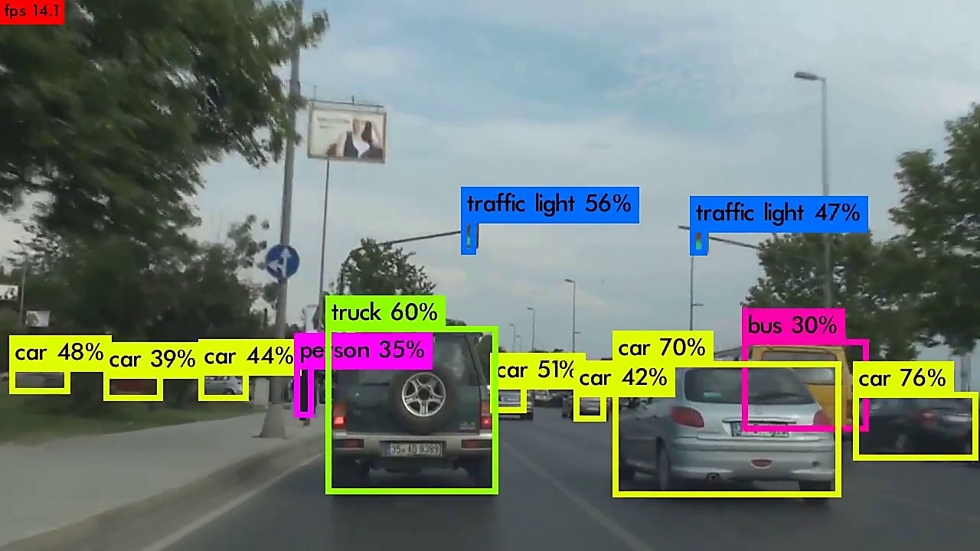
Introduction
Our task for exam project is to reimplement the model from the paper ‘YOLOv3: An Incremental Improvement’, train it on a dataset (either COCO or PASCAL_VOC) and compare it to the original implementation or to recreate the experiments.
This presentation will explain the work done so far and will elaborate on future work left to be done (therefore this presentation would not dive into theoretical details yet).
For further details for each code , the observer have the choice of deeper understanding using the comments and the text codes in the codes.

Slide 3
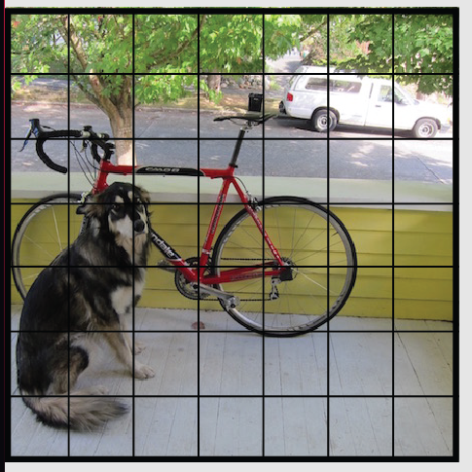
YoloV1_the_model.ipynb/py
The paper for YOLOv3 misses a lot of information (specifically the architecture of the bounding box prediction part of the model and loss functions).
Thus we thought that it would be wiser to first understand the previous version model and its workflow, losses and how to deal with datasets.
We have started by trying to implement ‘You Only Look Once: Unified, Real-Time Object Detection’ paper first.
Single neural network to get the class probabilities and the bounding boxes at the same time.
Only one look to get the results.
the network divides the image into regions and for each region, the model predicts both bounding boxes and class probabilities.
Notes:
We know that transformers were born a solution to RNNs, wasteful at training time, and they do sequential processing

Slide 4
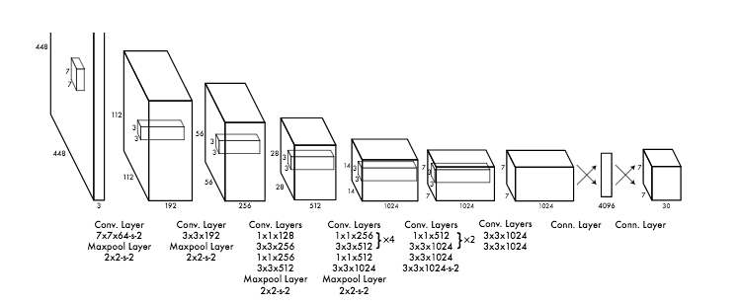
YOLOv1 architecture
Notes:
The encoder creates a contextualized representation for each input token using self-attention. And it adds information to this token from the other tokens.
Representations are dependent on all the input, not just one direction.
Self attention is the heart of the Transformer, and the beauty of self-attention is its simplicity it has only matrix multiplication, linear projection, and a SoftMax operation.

Slide 5
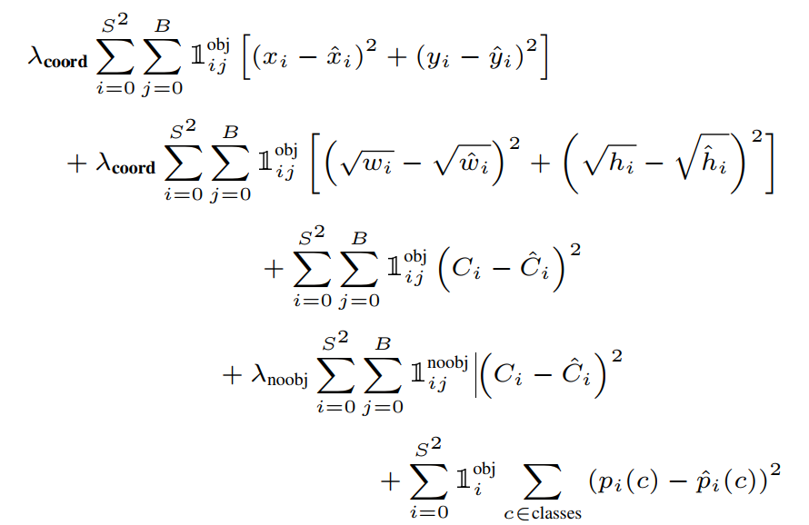
YOLOv1 Loss function:
Notes:
The encoder creates a contextualized representation for each input token using self-attention. And it adds information to this token from the other tokens.
Representations are dependent on all the input, not just one direction.
Self attention is the heart of the Transformer, and the beauty of self-attention is its simplicity it has only matrix multiplication, linear projection, and a SoftMax operation.

Slide 6
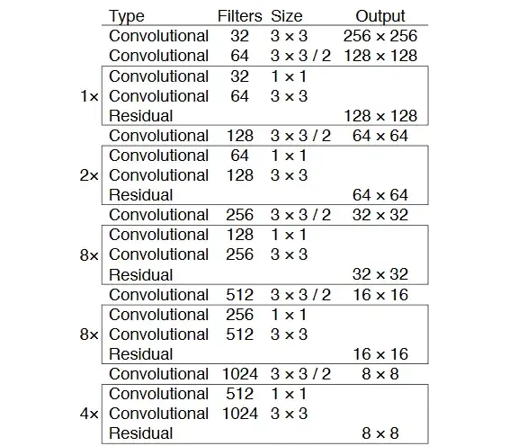
YOLOV3_the_model.ipynb
This code implements the original structure of the model’s neural network.
The model consists of two different parts: First, Feature extraction: using a DARKNET53. Second, Bounding boxes prediction (also 53 Conv Layers with Residuals).
Since the paper falls short in describing the Second part of the model (first part in the shown figure) , we have used the Config file (and other online resources mentioned in the code) of the original author to understand the structure of the model.
The outputted model is compared to the original implementation to insure the correctness of the structure.
Notes:
We know that transformers were born a solution to RNNs, wasteful at training time, and they do sequential processing

Slide 7
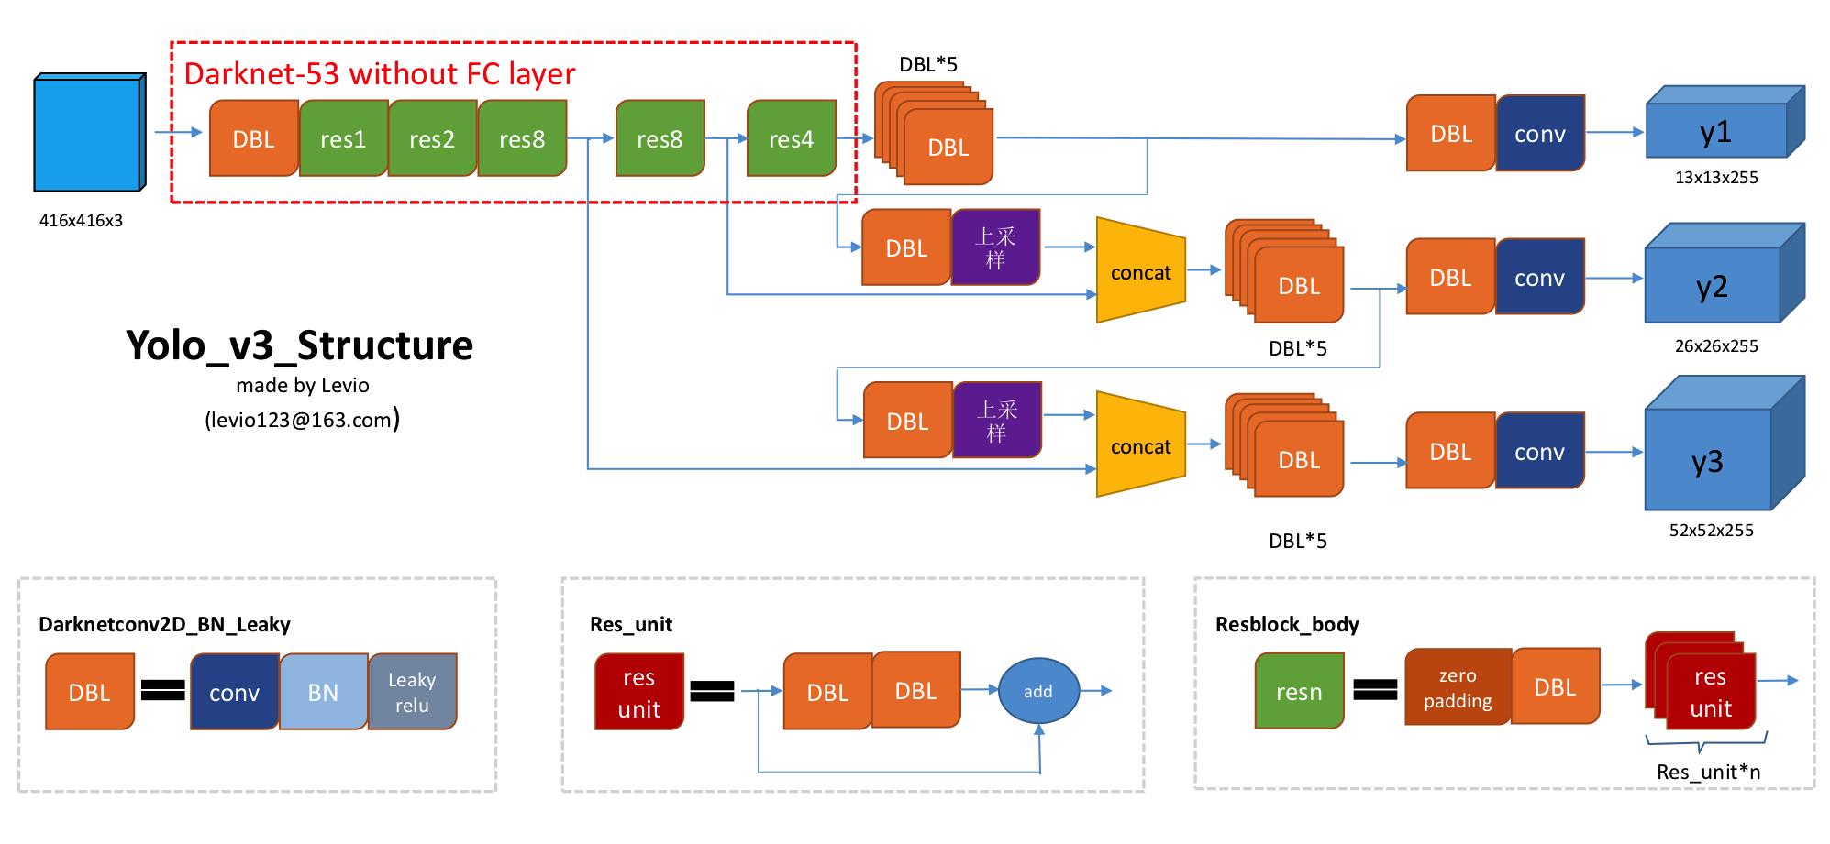
YOLOv3 architecture
Notes:
The encoder creates a contextualized representation for each input token using self-attention. And it adds information to this token from the other tokens.
Representations are dependent on all the input, not just one direction.
Self attention is the heart of the Transformer, and the beauty of self-attention is its simplicity it has only matrix multiplication, linear projection, and a SoftMax operation.

Slide 8
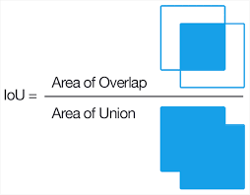
intersection_over_union.ipynb
IOU : is a metric that measures how similar a predicted bounding box is to the original bounding box.
This file implements the IOU metric, since the loss function would use it to compare the predicted bounding box and target real bounding box (provided by the Dataset).
Notes:
We know that transformers were born a solution to RNNs, wasteful at training time, and they do sequential processing

Slide 9
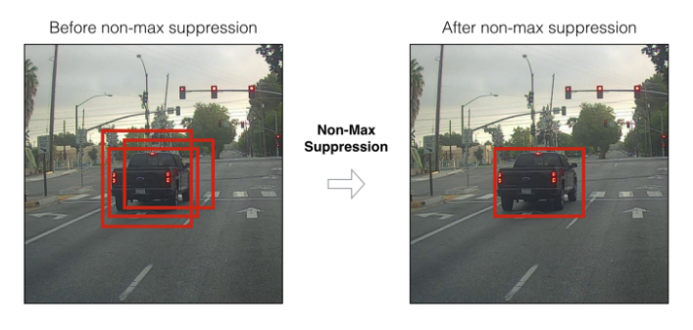
Non_Max_Suppression.ipynb
It is very common in YOLOv3 that multiple bounding boxes predict the same object. So, this code keep the bounding box with highest IOU. This technique is called NMS.
This technique is described in detail in the code, and it will be used to filter the model’s predictions for bounding boxes.
Notes:
We know that transformers were born a solution to RNNs, wasteful at training time, and they do sequential processing

Slide 10
YOLOv3_loss_function.ipynb
This code describes the loss function that we are going to use to train the model.
It is heavily based on resources form this and this .
This loss function have not been tested yet since we are going to train the model on the dataset (either PASCAL or COCO).
Notes:
We know that transformers were born a solution to RNNs, wasteful at training time, and they do sequential processing

Slide 11
Future work and current difficulties
The paper doesn’t provide enough description for the key elements to correctly implement the model.
acquiring a fully annotated dataset.
We are expecting to :
1- either train the model if we have the sufficient hardware resources (since both datasets have huge sizes) or used the pretrained weights (provided by the official website) on our model.
2- test the model on a test dataset (COCO test/val 2017 Dataset).
3 - (expected) recreate the experimental results using our model.
Notes:
We know that transformers were born a solution to RNNs, wasteful at training time, and they do sequential processing

Slide 12
Please note: you can visualize members’ contributions from the commit history of the GitHub repository.

